Slide 1

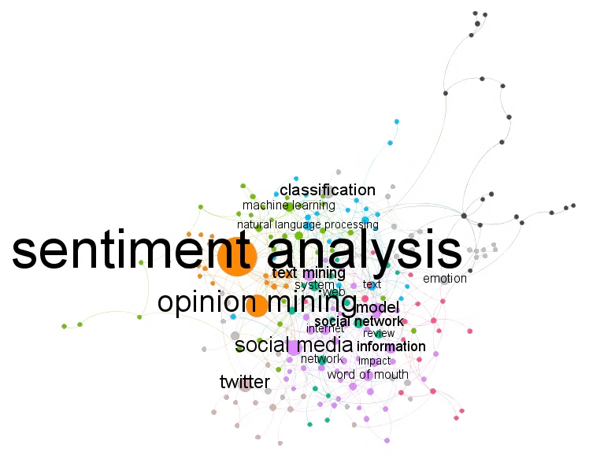
Document Sentiment Analysis Using Opinion Mining
Presented by
M. Vishnu Vardhan Reddy,
P. Sai Ganesh
192212303,192212333
(Electronics and Communication Engineering)
Guided by: Dr. Dhanalakshmi

Slide 2
Problem Statement
Unlock the Power of Customer Sentiment
In today's digital world, businesses are drowning in a sea of customer data - from social media posts to online reviews. But sifting through all that unstructured text to understand what your customers really think can feel like finding a needle in a haystack.
Traditional sentiment analysis methods are often manual, subjective, and slow. They just can't keep up with the volume of data, leading to missed opportunities and delayed decision-making. It's time for a better way.
1
Automated Sentiment Analysis
2
Real-Time Insights
3
Actionable Recommendations
Uncover trends and patterns in customer sentiment as they happen, not weeks later
An AI-powered solution that can quickly and objectively process mountains of customer feedback
Get clear, data-driven guidance to improve products, services, and the customer experience

Slide 3

Aim:
The aim of this project is to develop a Document Sentiment Analysis System using Opinion Mining techniques, with the goal of automatically identifying and categorizing sentiments expressed in textual documents. This system will analyze customer feedback, product reviews, and public opinions, enabling organizations to derive actionable insights for decision-making and improving customer experiences.

Slide 4




Abstract
1
Sentiment Analysis Process
2
NLP Methodology
3
Opinion Mining Algorithms
4
Actionable Insights
This project focuses on the development of a Document Sentiment Analysis System that employs Opinion Mining techniques to evaluate the emotional tone of text within various documents. By utilizing Natural Language Processing (NLP) algorithms, the system categorizes sentiments into positive, negative, or neutral classifications. It processes text from diverse sources, including customer reviews, feedback, and social media content. The system aims to offer valuable insights that help organizations understand customer perceptions, enhance product offerings, and refine marketing strategies. Through sentiment analysis, businesses can take proactive steps to address customer concerns, optimize satisfaction, and align their strategies with customer needs.

Slide 5

Introduction
Sentiment analysis, a key component of opinion mining, has become an essential tool for understanding public opinions and consumer sentiments from large volumes of text data. As businesses and organizations increasingly rely on digital platforms for customer interactions, the need for efficient systems to analyze and interpret the emotions expressed in documents has grown. Document Sentiment Analysis Using Opinion Mining leverages advanced Natural Language Processing (NLP) techniques to automate the classification of sentiments from textual data. This system aims to identify the emotional undertone behind written content, categorizing it as positive, negative, or neutral. By employing these techniques, the system can process diverse types of content, such as customer reviews, product feedback, and social media posts, providing businesses with insights that can guide strategic decisions and improve overall customer satisfaction.
Early Research
Commercial Applications
Sentiment Analysis Systems
Opinion mining emerged as a field of study in the early 2000s, focusing on extracting subjective information from text.
The field has expanded rapidly, with applications in various industries, including marketing, customer service, and social media analysis.
Modern systems utilize advanced NLP techniques to automatically analyze and classify sentiments expressed in documents.

Slide 6

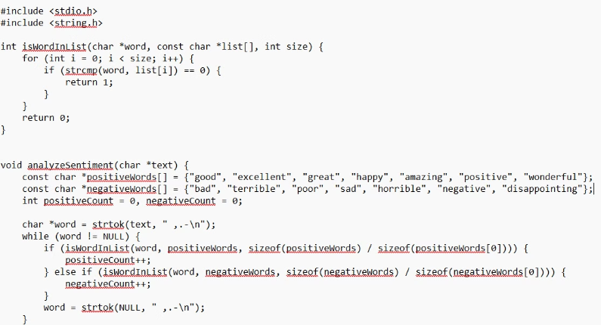
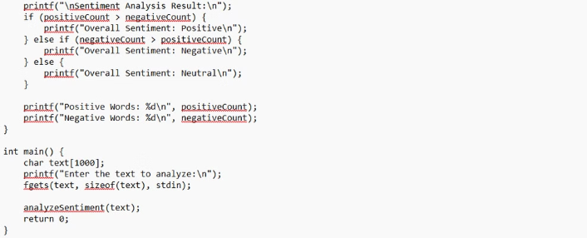
C Code Implementation

Slide 7

Engineering Standards
ISO/IEC 12207: Software Life Cycle Processes
ISO/IEC 90003: Software Engineering – Guidelines for the Application of ISO 9001:2000 to Software
IEEE 829: Software Test Documentation
IEEE 1012: Software Verification and Validation
ISO/IEC 25010: Software Engineering – Software Quality Requirements and Evaluation (SQUARE)
ISO/IEC 27001: Information Security Management Systems
ISO/IEC 15504 (SPICE): Software Process Improvement and Capability Determination
ISO/IEC 9126: Software Engineering – Product Quality
ISO/IEC 24765: Software Engineering – Vocabulary
ISO/IEC 9899-Define the C Language

Slide 8
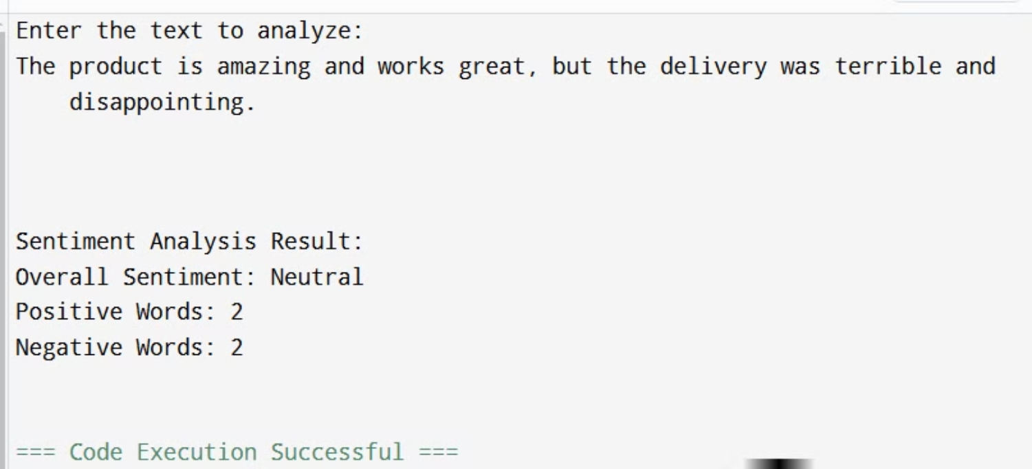

Slide 9




Future Scope
Multilingual Support
Expand the system to support multiple languages, enabling broader analysis.
Real-Time Sentiment Monitoring
Develop a real-time sentiment monitoring system to track changes in public opinion.
Integration with Other Tools
Integrate the system with other business intelligence tools for enhanced decision-making.

Slide 10

Conclusion
This project successfully demonstrates the potential of document sentiment analysis using opinion mining techniques. By leveraging natural language processing (NLP) and machine learning, the system provides valuable insights into customer sentiment. This enables data-driven decision-making and enhances overall customer satisfaction.
The core of the system involves applying advanced text analysis algorithms to extract and quantify the emotional tone and opinions expressed within customer feedback documents. This allows businesses to gain a deeper understanding of how their products, services, and brand are perceived in the market.
Future development will focus on expanding the system's capabilities and applications to address evolving needs in the digital landscape. This may include integrating the sentiment analysis with other data sources, automating feedback processing, and delivering actionable insights to key stakeholders. The goal is to continuously refine and enhance the system to better support data-driven decision-making and customer-centric strategies.

Slide 11

Thank You!
We appreciate your time and interest in our presentation.
We hope you found it informative and valuable.

